Slide 1
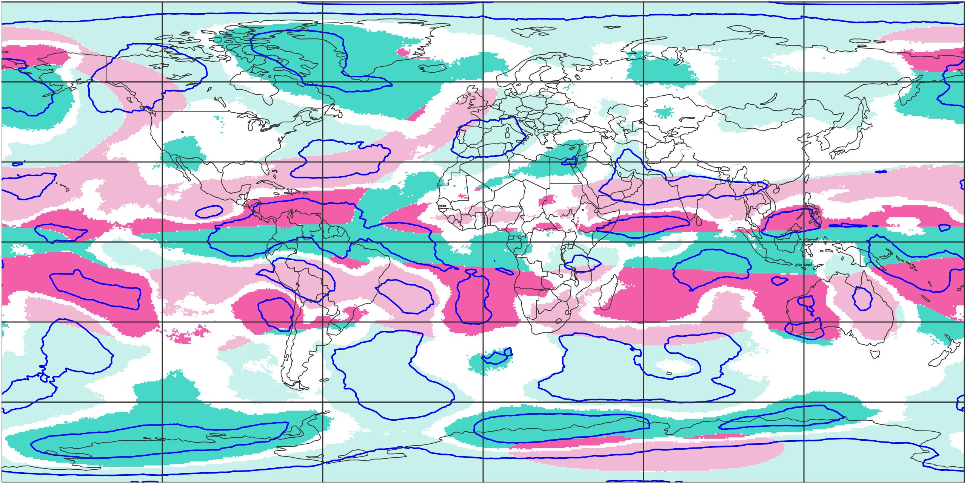
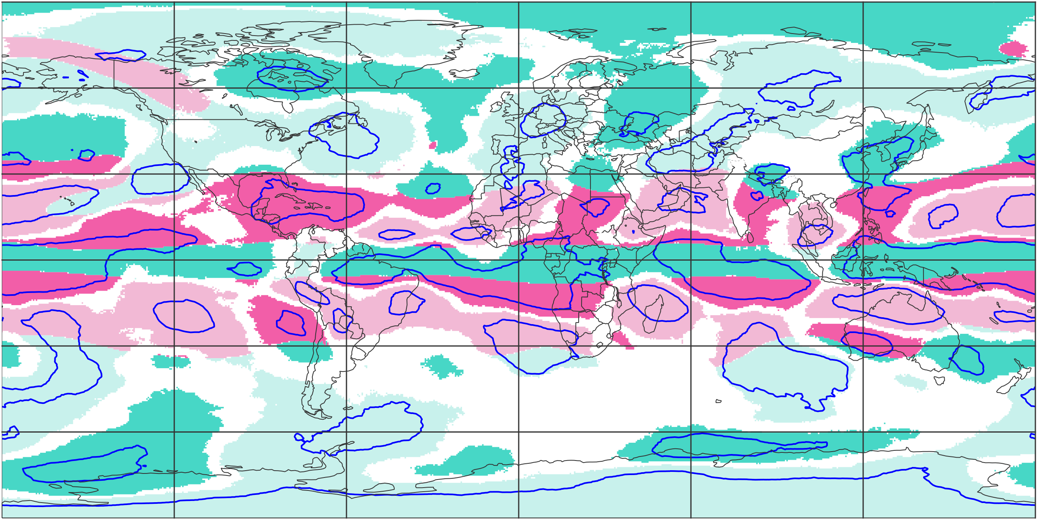
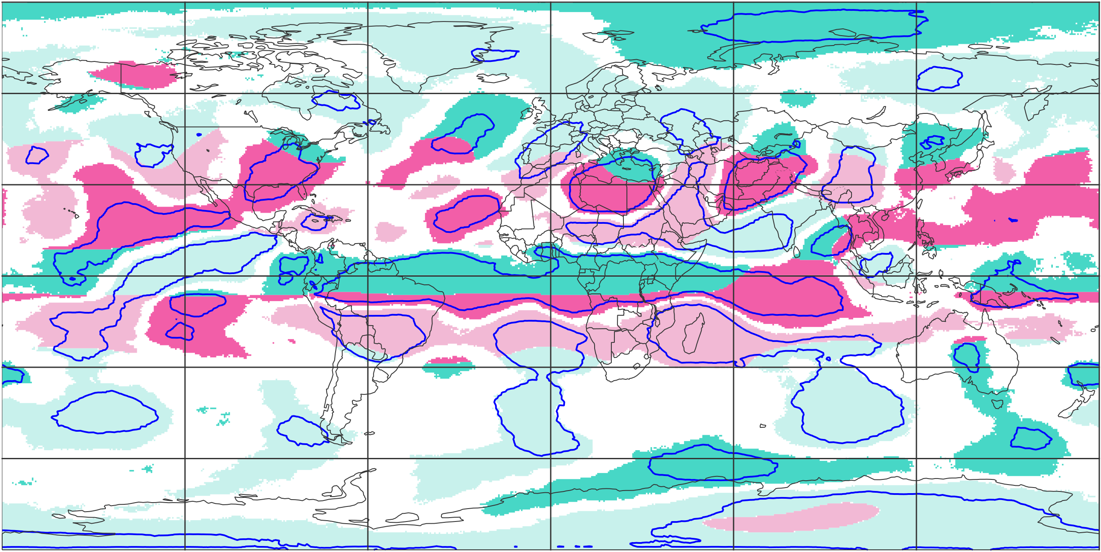
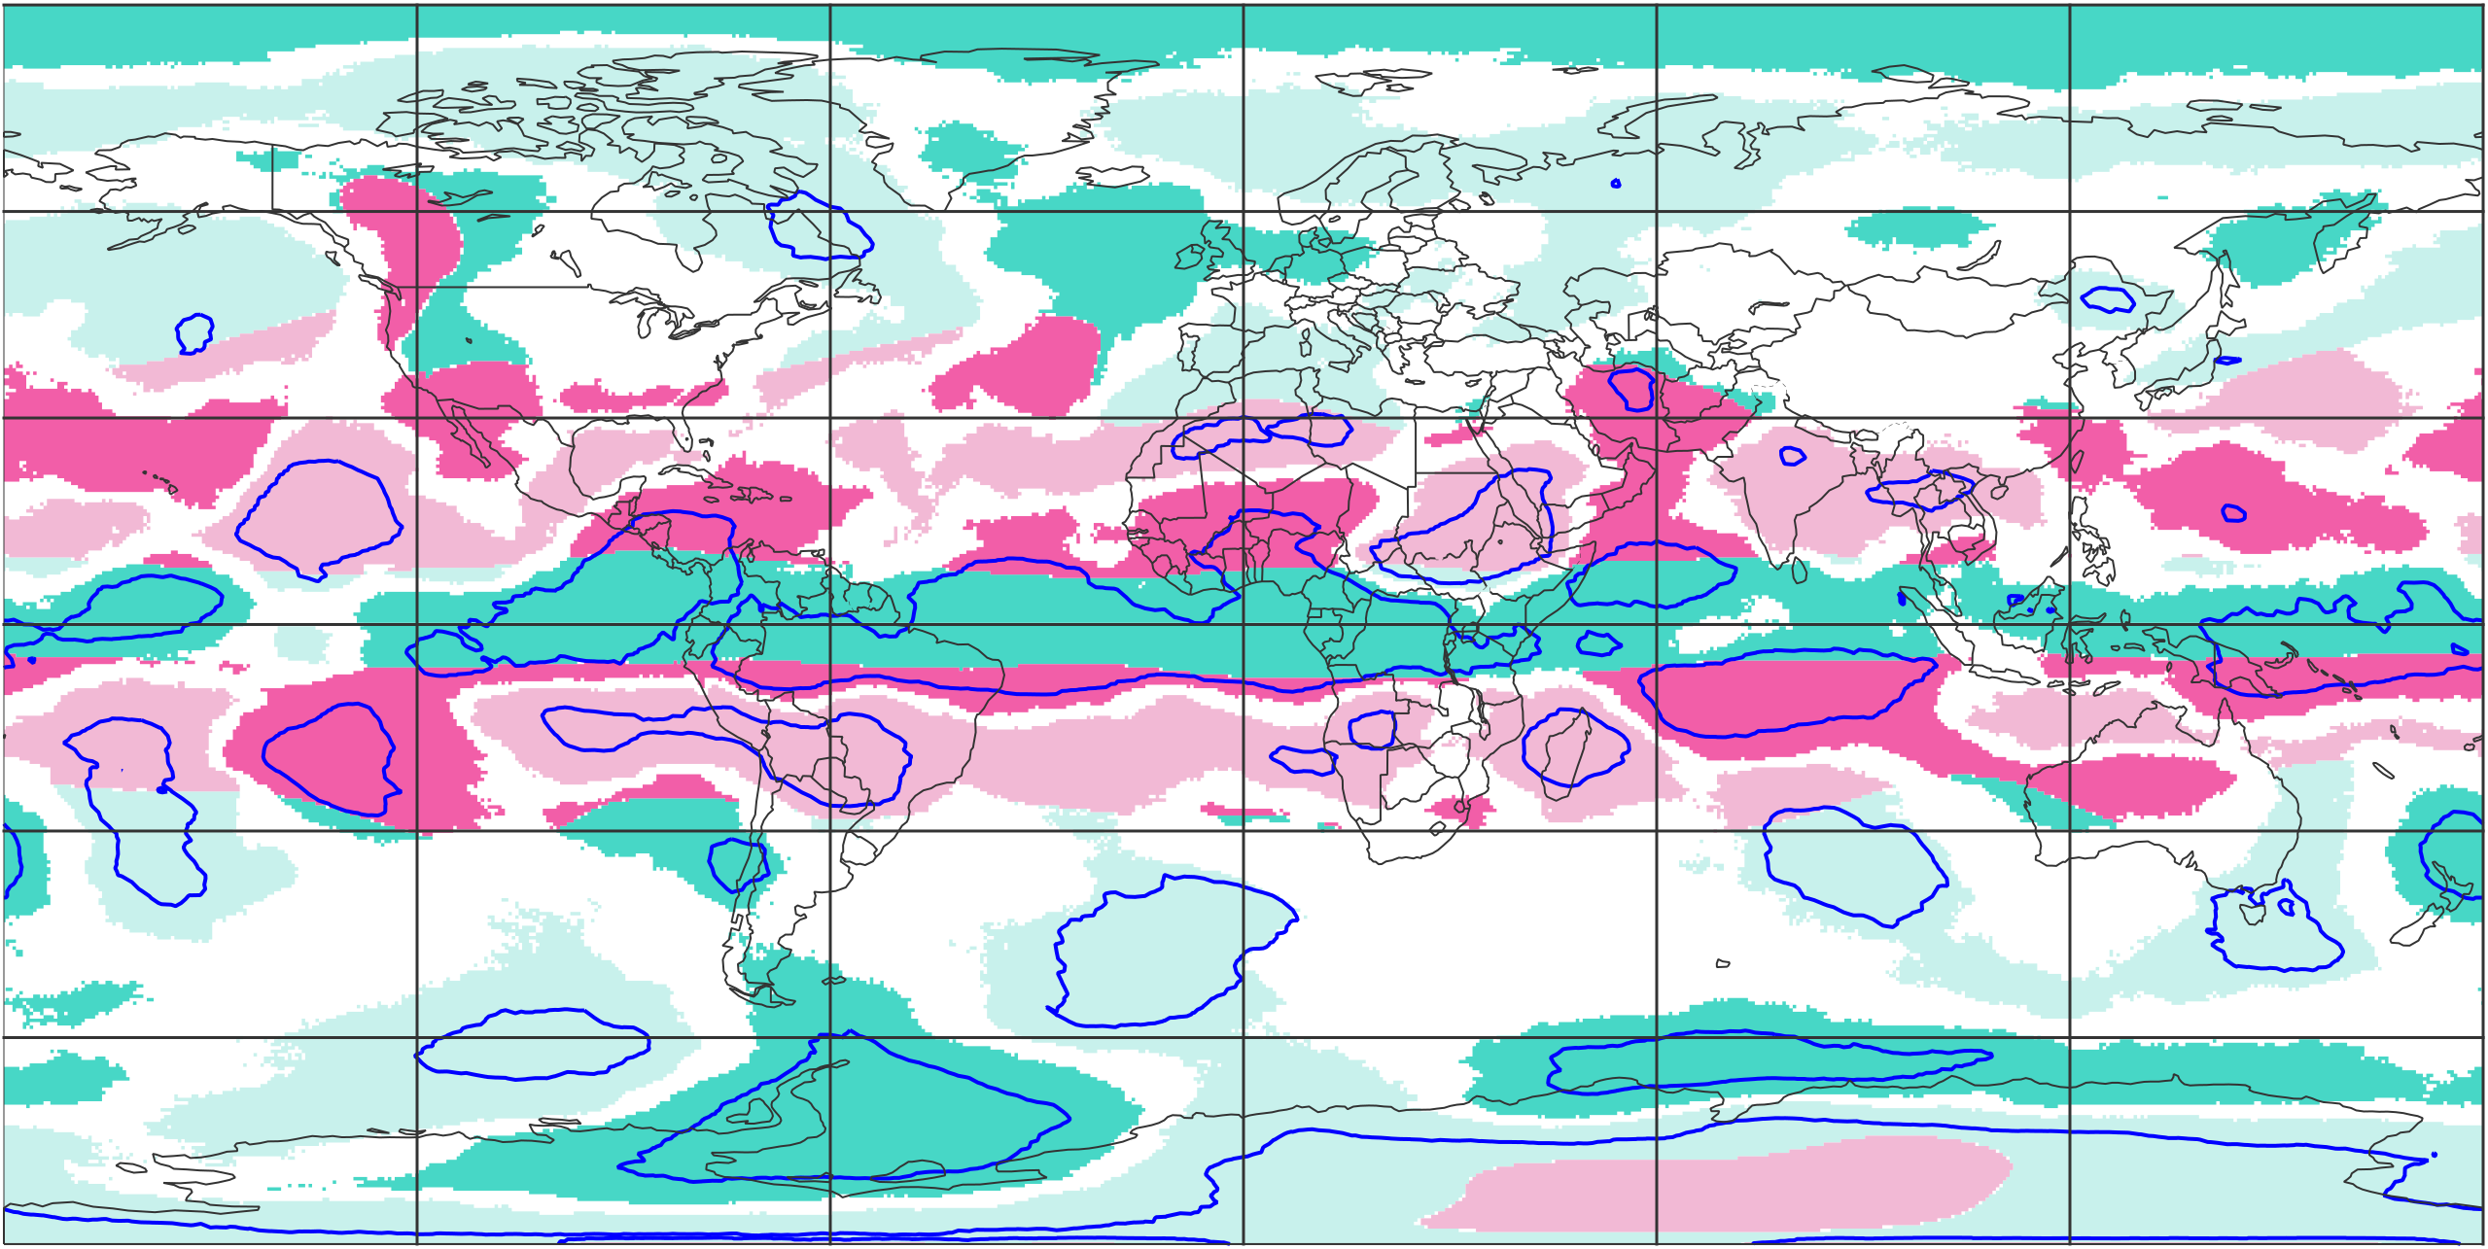
Trend for annual average CURV between 1950 and 2024
CURV computed with a radius of 2000m
mostly cyclonic
over whole period
mostly anticyclonic
over whole period
upward
trend
downward
trend
upward
trend
downward
trend
trends with 95% confidence level
(a) DJF
(b) MAM
60 °N
30 °N
0 °N
30 °S
60 °S
(c) JJA
(d) SON
60 °N
30 °N
0 °N
30 °S
60 °S
120 °W
60 °W
0 °E
60 °E
120 °E
120 °W
60 °W
0 °E
60 °E
120 °E

